Slide 1

Modern App Deep Dive
Anthony Handley
UX Practice Lead
Brent Edwards
Principal Lead Consultant
Allen Conway
Lead Consultant
Level: Intermediate

Slide 2
Brent Edwards
BrentE@magenic.com
@brentledwards
http://www.brentedwards.net
https://github.com/brentedwards

Slide 3
MyVote
A Modern App
Notes:
[DEMO]
MyVote is a multi-platform voting app.
You can create a poll, take a poll, and see the results of polls.
Polls can have images and they are stored in Azure Blob Storage.
When a user signs up, they fill out some basic info. This allows us to do some demographic data mining.

Slide 4




MyVote App Architecture
HTML 5 UI
iOS UI
UWP UI
Android UI
JavaScript BL
BL
BL
BL
Service Proxy
Data Portal
Data Portal
Data Portal
Reports
SQL Reporting
REST API
Data Portal
ASP.NET WA
BL
Excel
DAL
PowerPivot
SQL Database
Blobs
Notes:
This is the MyVote architecture as it stands today.
We’re going to look at how we got to this point.

Slide 5
MyVote Client Platforms
Universal Windows
iPad
Android
Web

Slide 6
MyVote Server Technologies
ASP.NET MVC
Azure
SQL Server
CSLA
Notes:
ASP.NET MVC4 drives the REST API and the Web client.
CSLA is the business object framework we use for the business logic.
Azure for web hosting as well as blob storage
SQL Server 2012 for the database

Slide 7
Myvote From the ground up

Slide 8





Azure
MyVote
SQL Server Database
Blob Storage
Mobile Services
Cloud Services
Website

Slide 9
Azure sql server database

Slide 10
Azure SQL Server
SQL Server Data Tools (SSDT)
Create Visual Studio Database Project
Can check into source control
All devs have access
Can publish right from Visual Studio
One catch: Basic Edition times out. Need to have Standard Edition at a minimum

Slide 11
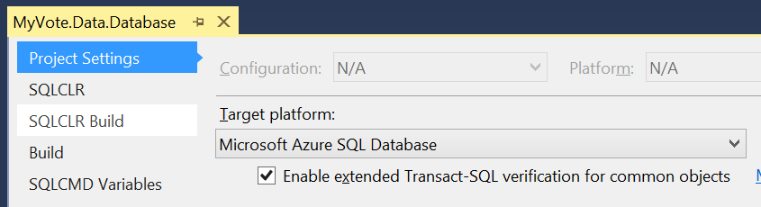
Azure SQL Server
Target Platform: Microsoft Azure SQL Database

Slide 12
Azure SQL Server Database
[DEMO]

Slide 13
Azure blob storage

Slide 14
Azure Blob Storage
Store Poll Images as Blobs
Give upload access on-demand
Generate Storage Access Security (SAS) Key

Slide 15
Storage Access Security (SAS)
What is it?
Temporary key
Has built-in expiration
SAS keeps credentials out of client
Recommend generating on server

Slide 16
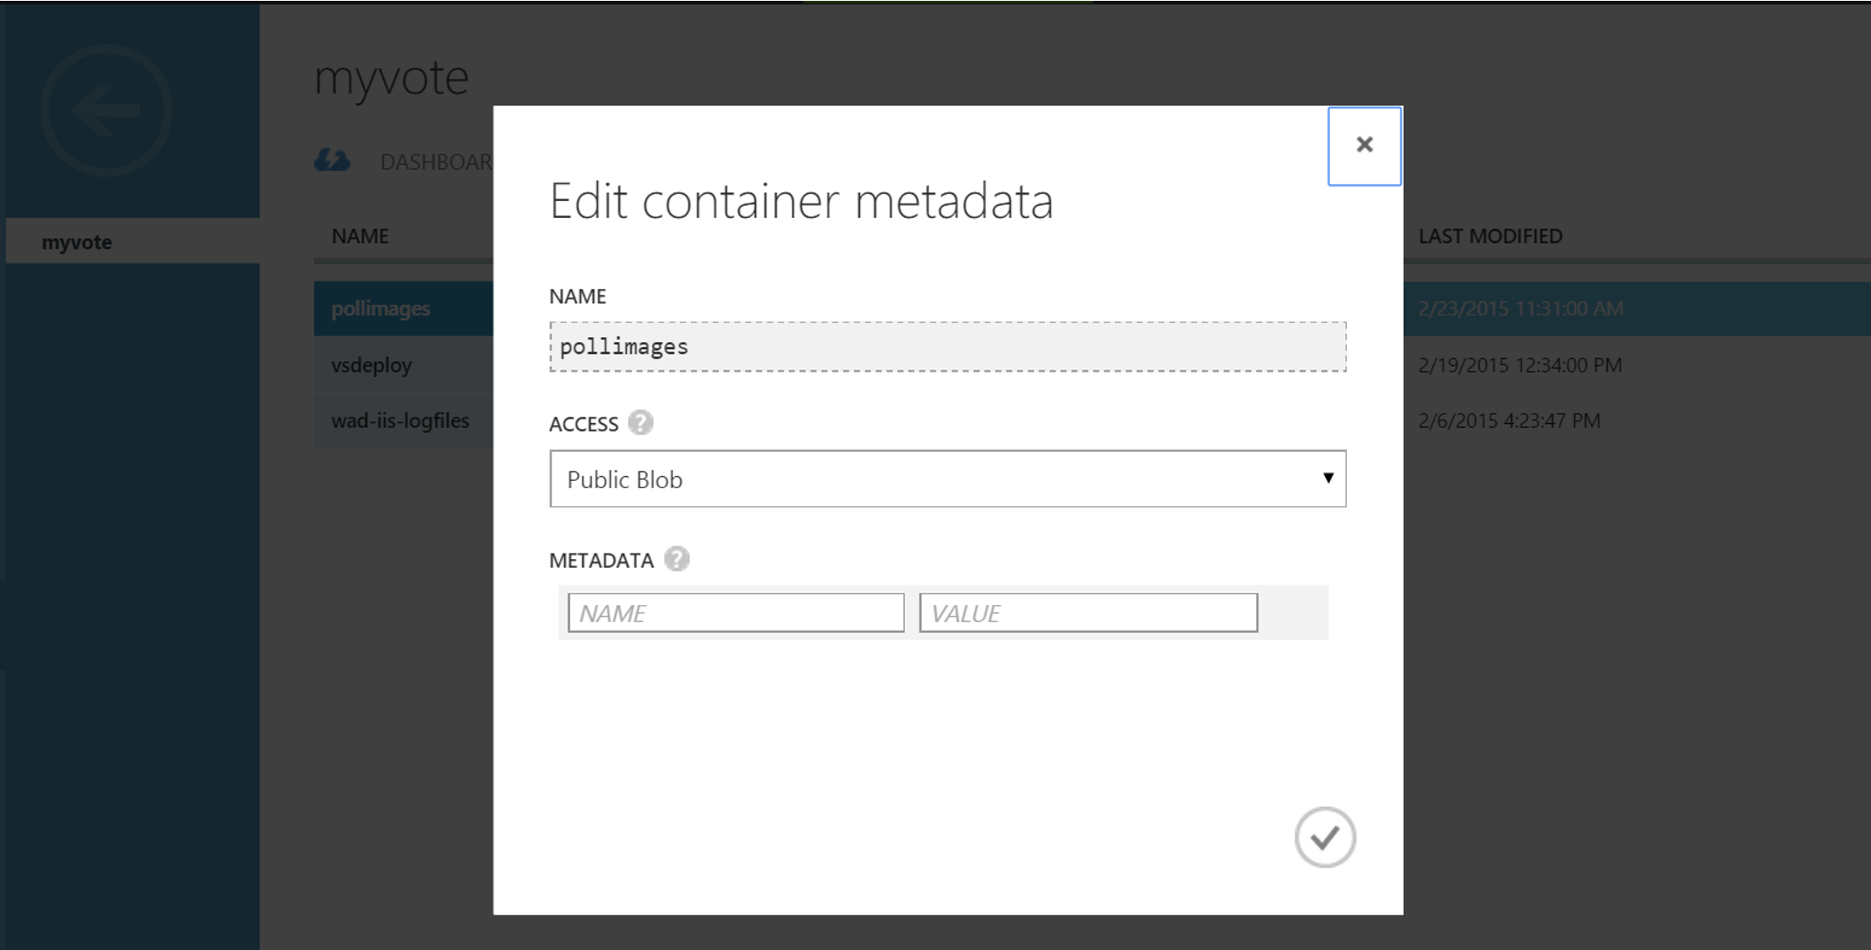
Azure Blob Storage
Configure access as Public Blob

Slide 17
Azure Blob Storage
A Couple of Options For Apps
Nuget Package
Windows Azure Storage
REST API

Slide 18
Windows Azure Storage Library
Nuget Package
Gives access to containers and blobs
Can use credentials directly
Better yet, use SAS

Slide 19
REST API
Provides all Blob Storage functionality
Create containers
Upload blobs
Can use credentials directly
Better yet, use SAS

Slide 20
Azure blob storage
[DEMO]

Slide 21
Azure Mobile Services

Slide 22
Azure Mobile Services
Primary Features
Authentication
Push Notifications

Slide 23
Authentication
oAuth done easy
4 Auth Options
Twitter
Facebook
Microsoft
Google
Biggest Drawback
Users have to remember which option they chose

Slide 24
Authentication
Things to consider
Is your app open to anyone?
Does your app need domain authentication?
If so, Azure Mobile Services is probably not the best option for auth

Slide 25
Push Notifications
Deliver info to your users through notifications
Tile
Badge
Toast
Things to consider
How can your Tile be more Live?
What info to show in Toasts?

Slide 26
Azure Mobile Services
Can create project in Visual Studio
Add SAS key generation code
Check into source control
Can remotely debug on the server

Slide 27
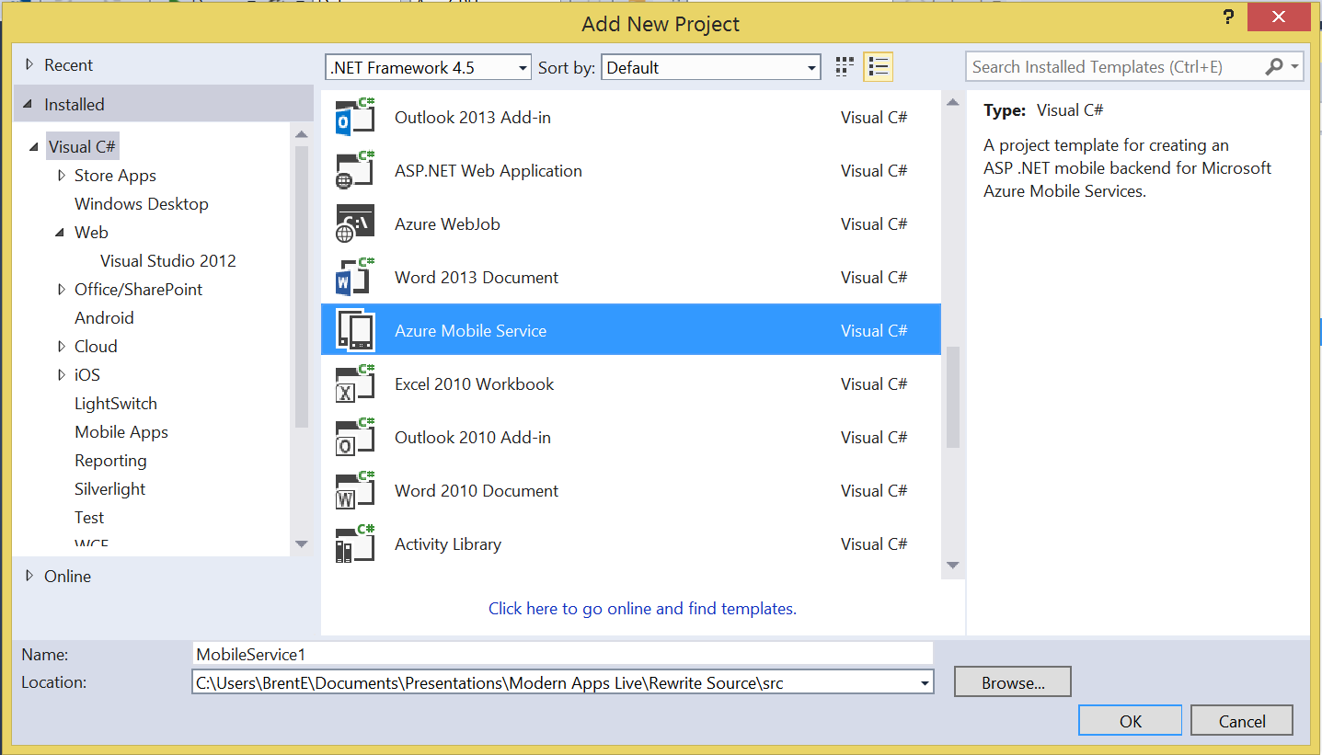
Azure Mobile Services

Slide 28
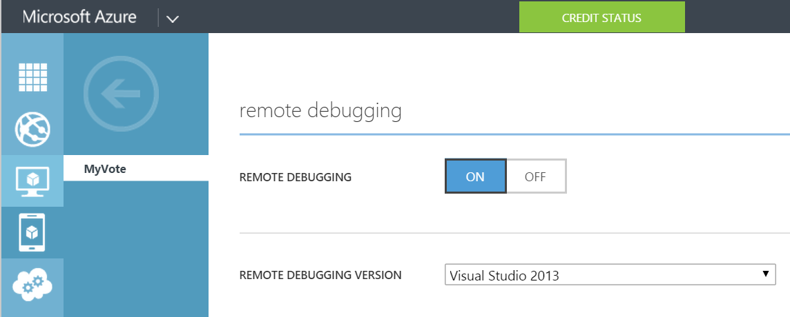
Azure Mobile Services

Slide 29
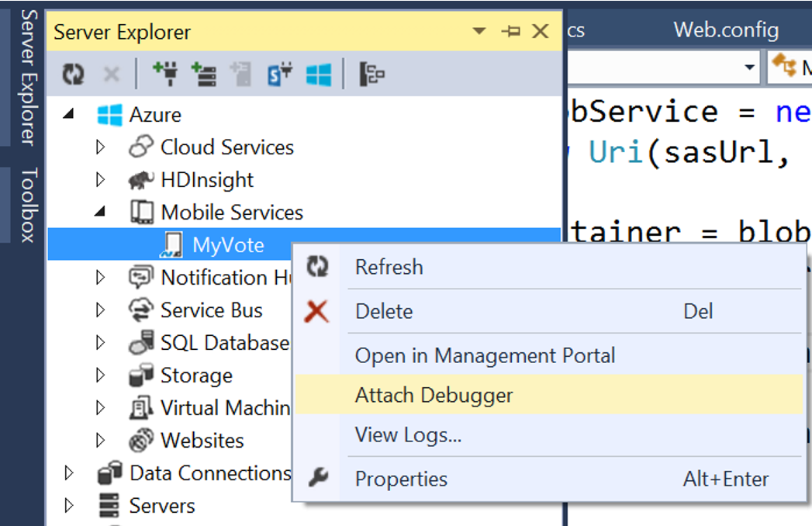
Azure Mobile Services

Slide 30
Azure Mobile Services
[DEMO]

Slide 31
Azure Cloud Services

Slide 32
Azure Cloud Services
Like a website, but more control
Hosts MyVote web services
We couldn’t use a website (we tried)
Cloud Service project wraps a web project
Can deploy from Visual Studio
Notes:
Website type was too restrictive for our code. We got errors as soon as we deployed. Seemed to have been centered around logging and diagnostics.

Slide 33
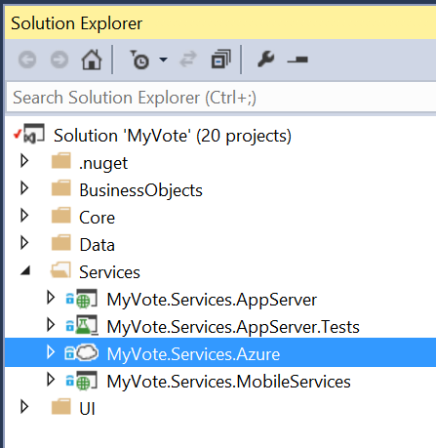
Azure Cloud Services

Slide 34
Azure Cloud Services
[DEMO]

Slide 35
Azure Websites

Slide 36
Azure Websites
Host MyVote web client
Allen will cover this later

Slide 37
MyVote Client Apps
Notes:
Break time?

Slide 38
MyVote Client Apps
Goals
As many platforms as possible (for us)
Match platform look-and-feel
Maximize code re-use

Slide 39
MyVote Client Apps
Technology Options
Fully Native
No code re-use
Cross-platform solution
Xamarin
PhoneGap

Slide 40
MyVote Client Apps
Our Technology Decision
Universal Windows Platform
Xamarin.Forms for Android/iOS
JavaScript for Web
Least ability for re-use
Allen will cover this later

Slide 41
What is Xamarin?

Slide 42
What is Xamarin?
A way to build native apps for iOS and Android using C#
Built on the Mono framework
Still have to write different code for each platform’s UI

Slide 43
What is XAMARIN.FORMS?

Slide 44
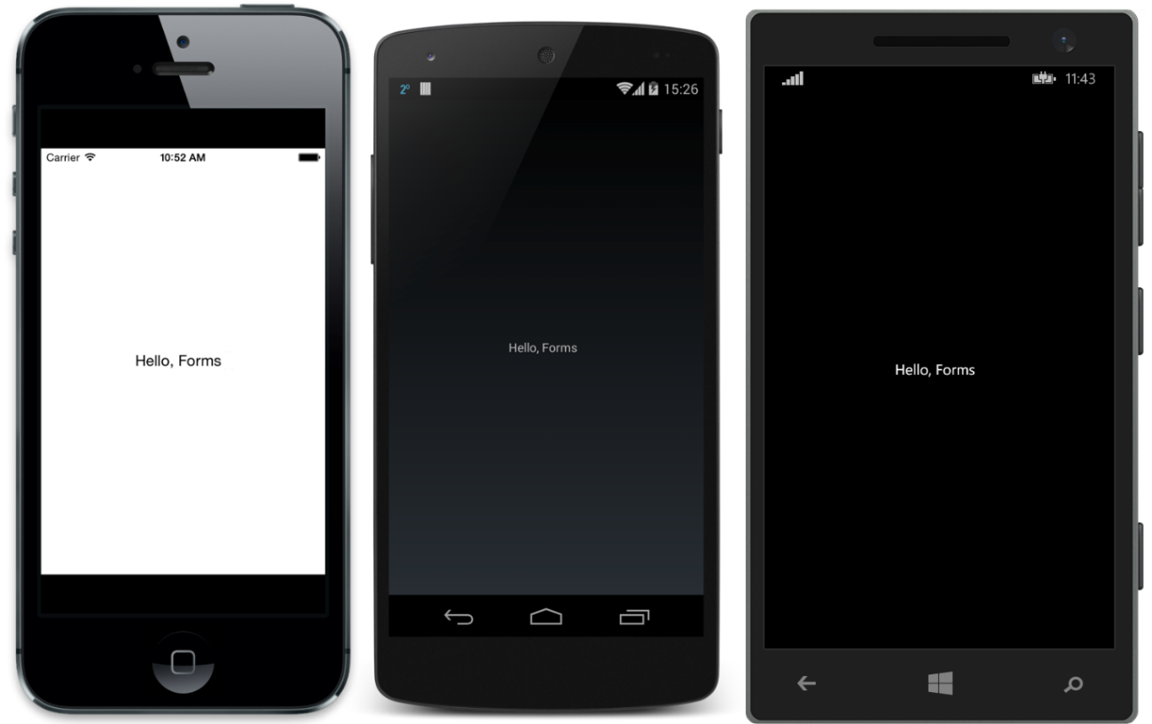
What is Xamarin.Forms?
Source: http://developer.xamarin.com/guides/cross-platform/xamarin-forms/introduction-to-xamarin-forms/

Slide 45
What is Xamarin.Forms?
A UI abstraction layer for Xamarin
Write apps once, run on:
iOS
Android
Windows Phone

Slide 46
What is Xamarin.Forms?
Suite of controls that map to native controls on each platform
Rendered with native look-and-feel
Framework for navigation and data binding

Slide 47
How does it work?
Xamarin.Forms Solution
Xamarin.Android Project
Native Android
Xamarin.iOS Project
Native iOS
Windows Phone Project
Native Windows Phone

Slide 48
Foundation

Slide 49
Xamarin.Forms Foundation
4 Main Classes everything is built on
View
Page
Layout
Cell

Slide 50
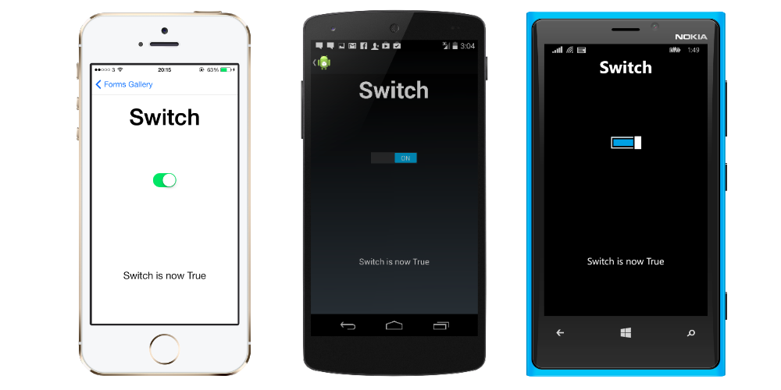
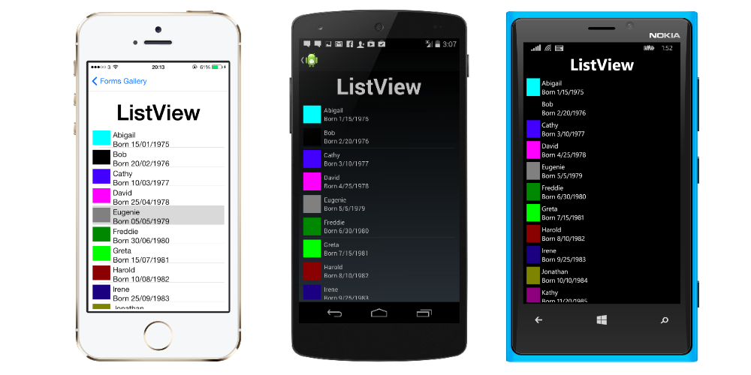
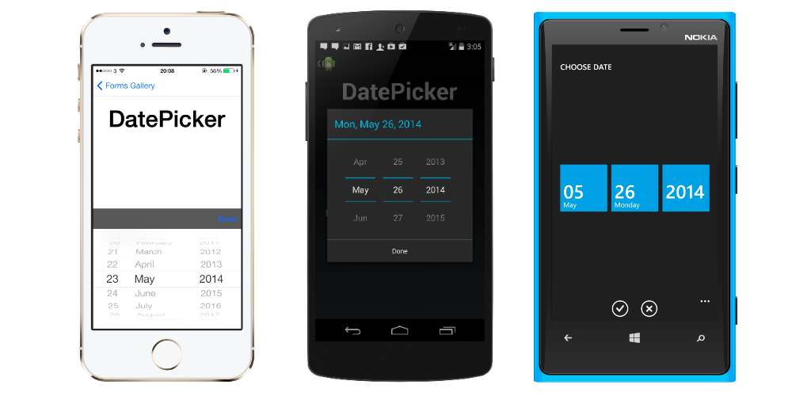
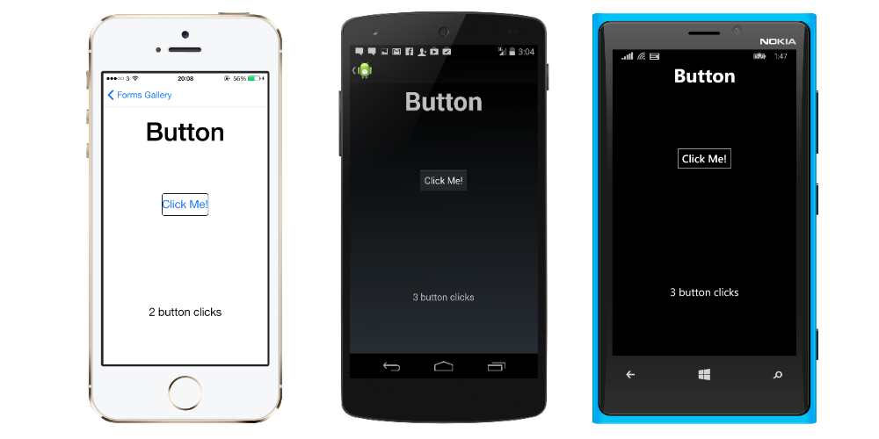
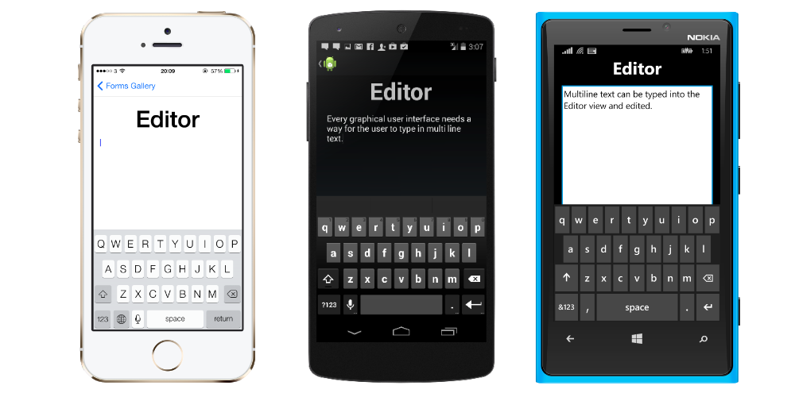
View
Typically called control or widget on native platforms
Examples:
Button
Editor
DatePicker
ListView
Switch

Slide 51
Page
Android
Activity
iOS
View Controller
Windows Phone
Page

Slide 52
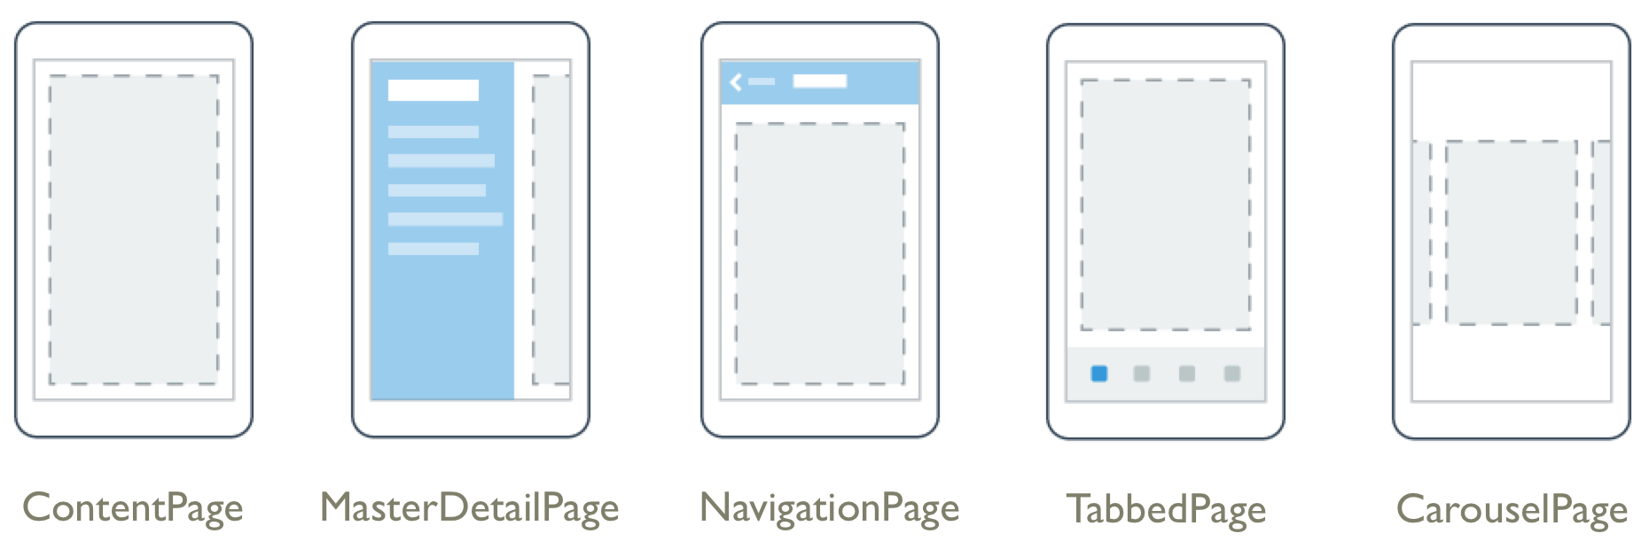
Page Examples
Source: http://developer.xamarin.com/guides/cross-platform/xamarin-forms/controls/pages/

Slide 53
Layout
Type of view used for… Layout!
Container for other Layouts or Views
2 Types
Managed
Unmanaged

Slide 54
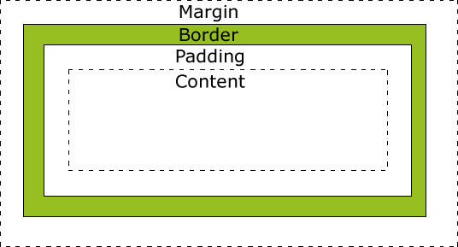
Managed Layout
Handles sizing and positioning child views
Follow CSS Box Model
Source: http://www.w3schools.com/css/css_boxmodel.asp

Slide 55
Unmanaged Layout
Does not handle sizing and positioning of child views
Developer sets this
Allows for precise positioning
Requires testing on many device sizes

Slide 56
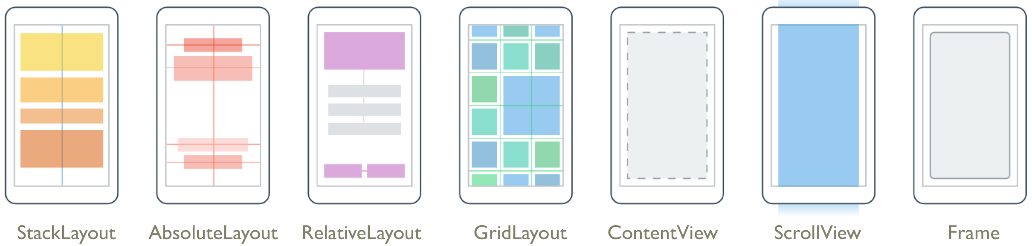
Layout Examples
Source: http://developer.xamarin.com/guides/cross-platform/xamarin-forms/controls/layouts/

Slide 57
Cell
Describes how items in a list or table should be drawn
Not a visual element
Like a DataTemplate in XAML
Designed for ListView and TableView

Slide 58
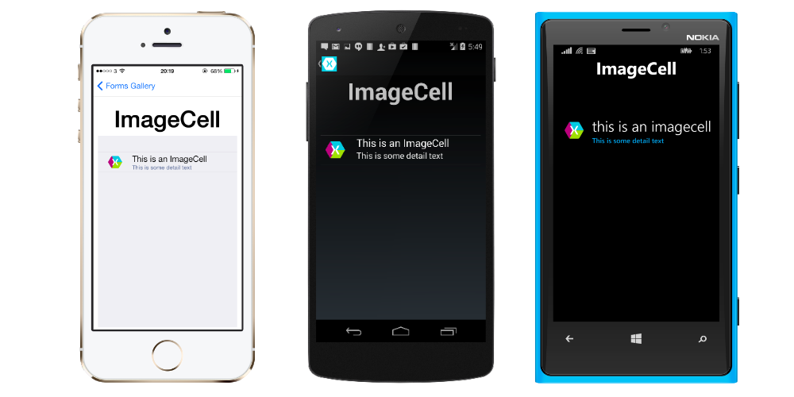
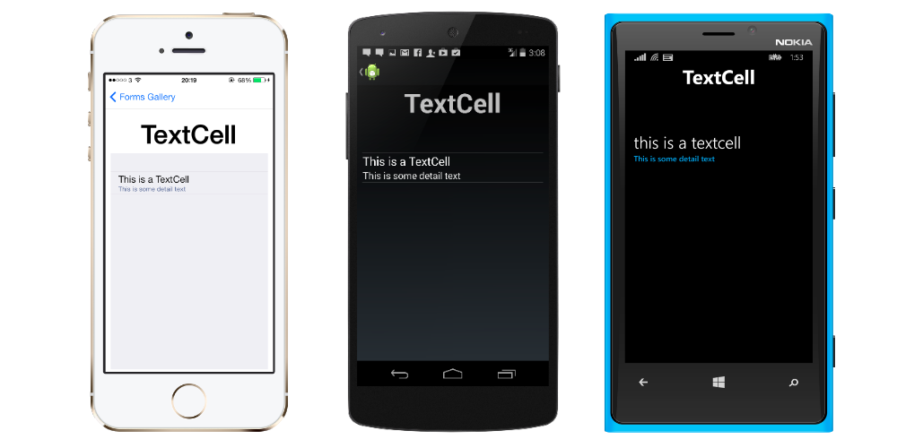
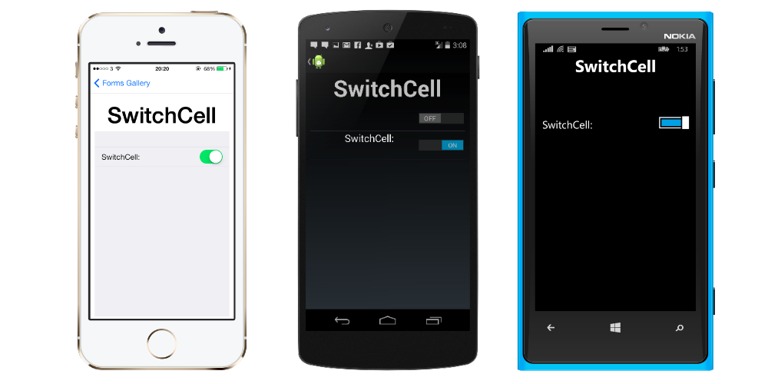
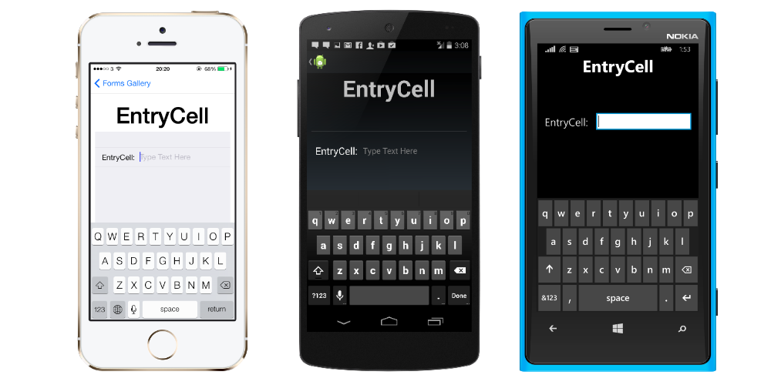
Cell
Examples:
EntryCell
SwitchCell
TextCell
ImageCell

Slide 59
Xamarin.Forms UI
[DEMO]

Slide 60
Going Custom

Slide 61
Going Custom
What about custom controls?
Create a custom Renderer!
Renderers output native controls for each platform
All controls use Renderers

Slide 62
Custom Renderers
Can tweak existing controls
Can create completely new controls
Lots of power

Slide 63
Custom Renderers
How to do it
Create custom control
Can inherit from existing types
Create custom renderer for each platform
This dives into Xamarin proper
Bind them together with ExportRenderer attribute
Tells Xamarin that they are a pair

Slide 64
Custom Renderers
[DEMO]

Slide 65
Universal Windows Platform

Slide 66
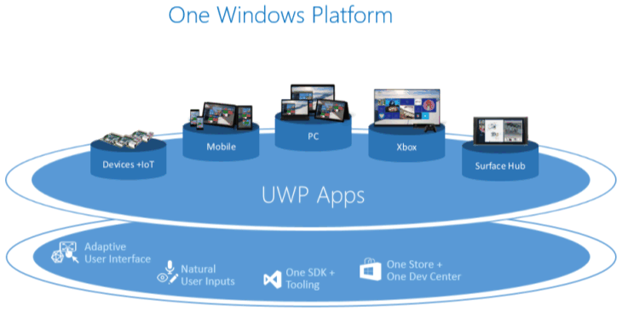
Universal Windows Platform
Source: https://msdn.microsoft.com/en-us/library/windows/apps/dn894631.aspx

Slide 67
UWP Device Families
Windows 8.1/Windows Phone 8.1 target an OS
Windows 10 provides common app platform
Targets Device Families
One package for all

Slide 68
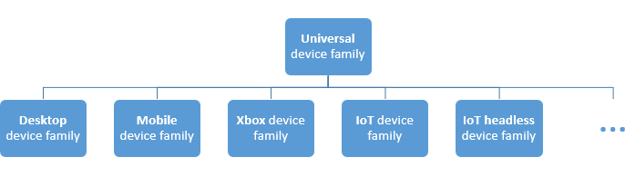
UWP Device Families
Source: https://msdn.microsoft.com/en-us/library/windows/apps/dn894631.aspx

Slide 69
UWP Foundation

Slide 70
Universal Stuff
Layouts
Controls
Styles

Slide 71
Example Controls

Slide 72

RelativePanel
Source: https://msdn.microsoft.com/library/windows/apps/windows.ui.xaml.controls.relativepanel.aspx

Slide 73
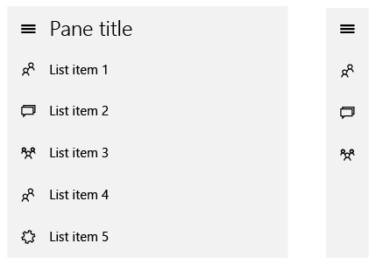
SplitView
Source: https://msdn.microsoft.com/en-us/library/windows/apps/dn997787.aspx

Slide 74
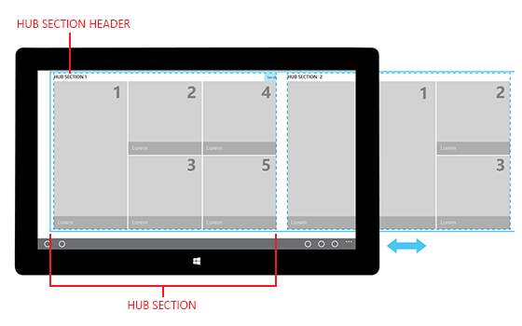
Hub
Source: https://msdn.microsoft.com/en-us/library/windows/apps/dn449149.aspx

Slide 75
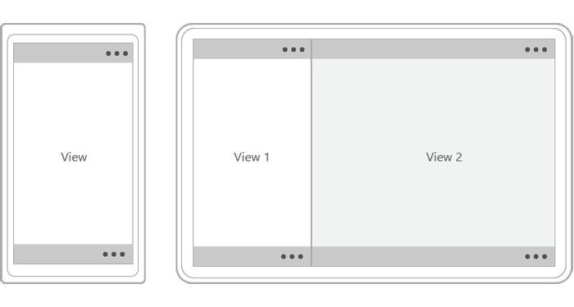
CommandBar
Source: https://msdn.microsoft.com/en-us/library/windows/apps/hh465302.aspx

Slide 76
UI Patterns

Slide 77
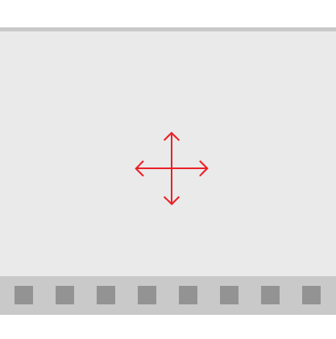
Active Canvas
Source: https://msdn.microsoft.com/en-us/library/windows/apps/dn997761.aspx

Slide 78
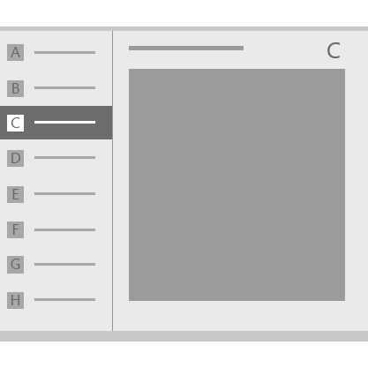
Master/Detail
Source: https://msdn.microsoft.com/en-us/library/windows/apps/dn997765.aspx

Slide 79
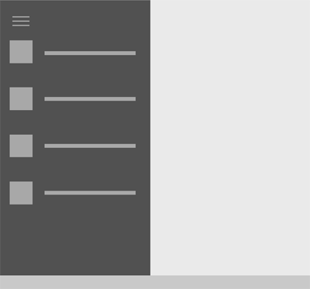
Nav Pane
Source: https://msdn.microsoft.com/en-us/library/windows/apps/dn997766.aspx

Slide 80
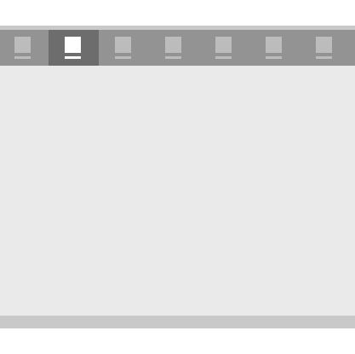
Tabs and Pivots
Source: https://msdn.microsoft.com/en-us/library/windows/apps/dn997788.aspx

Slide 81
Sharing code

Slide 82
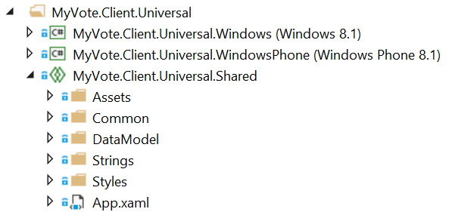
Universal Shared Projects
Essentially a code placeholder project
Does not compile on its own

Slide 83
Universal Shared Projects
Put common code in universal shared project
Platform-specific code in platform-specific projects
What is common?
Models
ViewModels
Converters
Services
What about views?
That depends…

Slide 84
What about Portable Class Library?
What is a PCL?
Single project that compiles for multiple platforms
Drawbacks
Lowest common denominator between platforms
Referenced assemblies must be PCL also
CSLA doesn’t support PCL

Slide 85
Universal Shared Projects
Included with VS 2015
For VS 2013
Shared Project Reference Manager
http://visualstudiogallery.msdn.microsoft.com/315c13a7-2787-4f57-bdf7-adae6ed54450

Slide 86
Windows and Xamarin Apps

Slide 87
Windows and Xamarin Apps
What can be re-used?
Core functionality
Business objects
View Models
Wait… What? How?
We’ll get to that shortly…

Slide 88
Windows and Xamarin Apps
What can’t be re-used?
UI

Slide 89
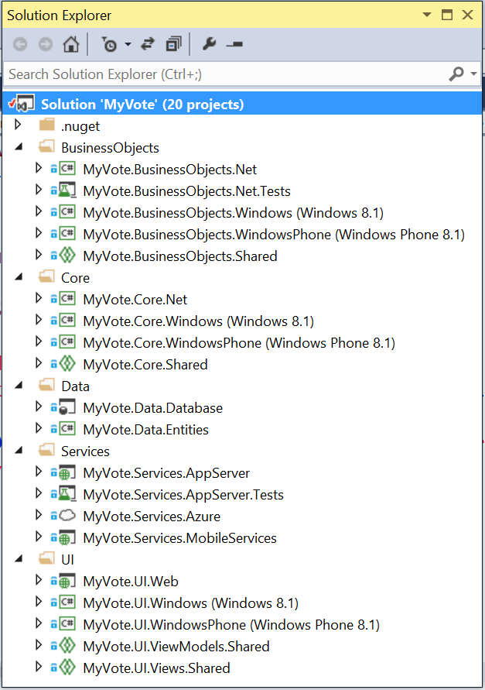
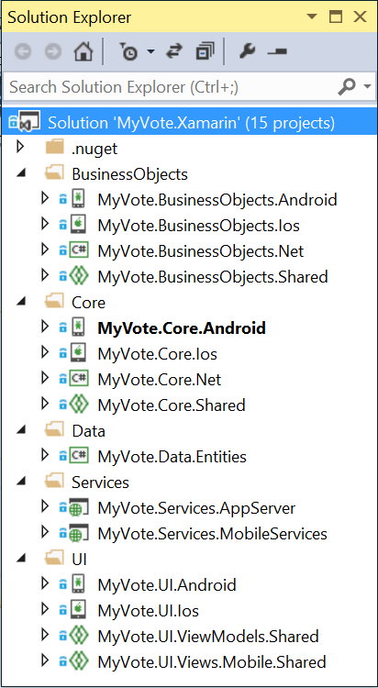
Solution Structure
2 Solutions
Windows/Server
Xamarin
Notes:
Not all team members may be working on Xamarin. Do them a favor and keep the Xamarin stuff seperate.

Slide 90
Maximizing Code Re-Use

Slide 91
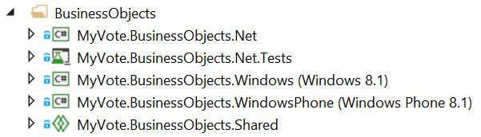
Maximizing Code Re-Use
Universal Shared Projects FTW!
Server
Clients
Shared

Slide 92
Re-Using Code
Foundation
Common code in Universal Shared Projects
Platform-specific projects for each client
Can use
Compiler Directives
Abstraction

Slide 93
Re-Using Code
[DEMO]

Slide 94
MVVM
Model-View-ViewModel

Slide 95
MVVM
View
Presentation
View Model
Presentation Logic
Model
Business Logic

Slide 96
Why is MVVM Cool?
Separates Presentation from Functionality
Promotes Testability
Works great with Data Binding
Easy collaboration with Designers
Makes it easy to change out the View layer!

Slide 97

MvvmCross

Slide 98
MvvmCross
Why use it?
Supports Xamarin.iOS, Xamarin.Android, UWP
Write view model layer once for all platforms

Slide 99
MvvmCross Foundation
Key Stuff
Inherit MvxApplication
Set first View Model or an AppStart
View Models inherit MvxViewModel
Better yet, implement a base ViewModel of your own
Xamarin.iOS
Inherit MvxSetup
Xamarin.Android
Inherit MvxAndroidSetup (which inherits MvxSetup)

Slide 100
MvvmCross Foundation
[DEMO]

Slide 101
UI on Multiple Platforms

Slide 102
UI on Multiple Platforms
Views have to be different
XAML can keep things similar
UWP has great support for responsive layouts
Xamarin.Forms supports their own XAML

Slide 103
Windows

Slide 104
Windows
XAML not as full featured as WPF
Lots of controls to choose from
Too many to list
Support for styling

Slide 105
Multiple Device Families
Can create responsive layouts
Lean on
GridView
RelativePanel
StackPanel
Visual States
AdaptiveTrigger

Slide 106

Xamarin.Forms

Slide 107
Xamarin.Forms
No Visual Designer
No Intellisense for XAML in Visual Studio
Xamarin Studio Windows Doesn’t do iOS
Way fewer controls than Windows out of the box
Up to you to add what you need

Slide 108
UI
[DEMO]

Slide 109
Parting Thoughts

Slide 110
Parting Thoughts
Put thought into solution structure and architecture first
Check out MvvmCross
Focus on one platform at a time
Reduce context switching
Don’t let one platform get too far ahead

Slide 111
Questions?

